Slide 1
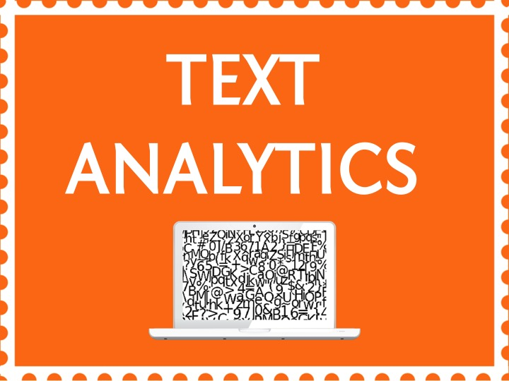

Slide 2
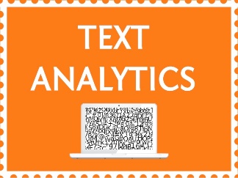

Topic – 2 Tm Package in R
Text Analytics
Notes:
Do we know the topic number for this?

Slide 3
INDEX
Introduction to tm package
Pre-processing the data
What is a Term Document Matrix?
What analysis can be done using a Term Document Matrix?
Implementation in R

Slide 4
INDEX
Introduction to tm package
Pre-processing the data
What is a Term Document Matrix?
What analysis can be done using a Term Document Matrix?
Implementation in R

Slide 5
This is a basic package in R for pre processing the text data
Introduction to tm() Package
Notes:
Tm package is a package provided by R to do text mining .Let’s look at its features more in detail.

Slide 6
INDEX
Introduction to tm package
Pre-processing the data
What is a Term Document Matrix?
What analysis can be done using a Term Document Matrix?
Implementation in R
Notes:
Source of information : Reviews from various websites through google search
From this source, we extracted the “dimensions” of the data – which is nothing but the words in the reviews.This adds some implicit structure to the otherwise unstructured data we’re dealing with.
The goal is to identify which are the best books to read.

Slide 7
Pre-Processing the Data
Remove unwanted lines of data
Convert text to a corpus
Reading a Corpus
Inspecting Corpora
Creating a TDM
Notes:
The data we have is large and has unstructured volumes of text information.
This is difficult to analyse directly as it is not in a table format.
So the first step is to pre process the data, ie clean the data and convert it to a structured format.
Some of the steps involved in them is to :
Remove unwanted lines of data:
Convert text to a structure called corpus
Reading a Corpus
Inspecting Corpora
Creating a TDM – Term Document Matrix

Slide 8
Pre-Processing the Data
Remove unwanted lines of data
Notes:
Sometimes when we read the text data in, we could remove unwanted lines of code, for example
We want to analyse the words and the subject matter in an Ieee paper ie a technical papaer. Let’s say this technical paper talks about how to implement a sentiment analysis.
Now generally the first 10 lines of an ieee paper /technical paper contains details about the author and the publication, which we may not need in our analysis.So Using this package we can just delete these few lines directly.
It’s important to first keep only relevant details of the document or text we are analysing.

Slide 9
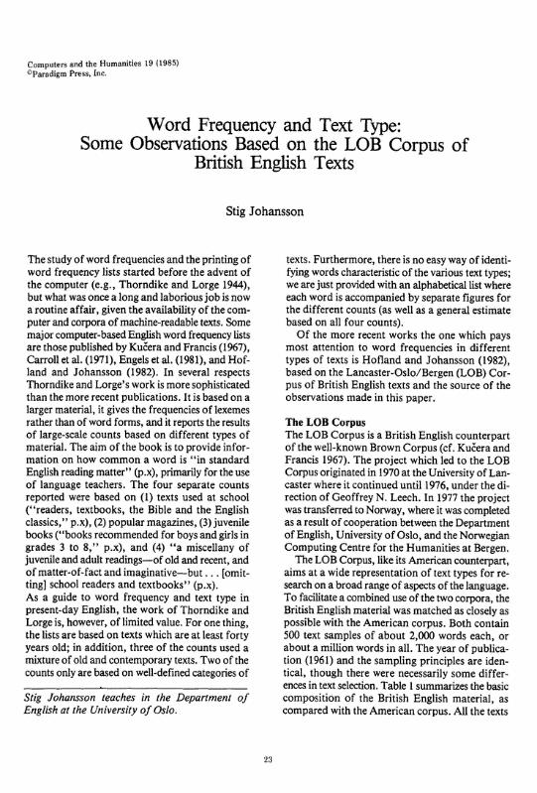
Pre-Processing the Data
What is a corpus?
A large and structured set of texts or documents
tm package helps us do this
Notes:
Next step is to convert this data to a corpus
Now what is a corpus?
It is defined as a large and structured set of texts or documents
Tm package helps us to convert unstructured data to a structured data ie a corpus before we further analyse the data
Say if you need in 10 documents , For example, it becomes easier to traverse through these 10 documents if it is in the form of a corpus.

Slide 10
Pre-Processing the Data
What is a corpus?
Parse the data
Extract words
Remove Stop Words
Eg : Was, an,a,it,etc.
Word Stemming
Eg : trying, tried, try, etc. with “Try”
Discard spaces & punctuation
Upper Vs Lower
Notes:
How to clean the corpus next?
Under cleaning we have various steps to make our text more meaningful.
1.Firstly : Parsing the data :
Extract words from the text sentences
Convert all the characters to one case ie upper or lower ase mostly lower case .This is because R is case sensitive.
For example, the word “Dance” with a small d and capital d would be considered as different words.
Discard spaces and punctuation
2.Remove stop words
Stop words are words which add no additional information to our analysis. For example was,an,it,etc
3.Stem the words :
Stem means keeping only the “roots” of the words.
For example if your documents have words like trying, try , tried which all mean the same but posses different tenses, we could replace all of this by one word
“Try”.
This process is called stemming of the data.

Slide 11
Pre-Processing the Data
What is a corpus?
Use the tm_map( ) function in R which applies (maps) a function to all elements of the corpus
Notes:
The main function used under the tm package in R for cleaning the data is the tm_map() function.
We will look at this more in detail when we implement these commands in R

Slide 12
INDEX
Introduction to tm package
Pre-processing the data
What is a Term Document Matrix?
What analysis can be done using a Term Document Matrix?
Implementation in R

Slide 13
Term Document Matrix
It describes the frequency of terms that occur in a collection of documents.
A mathematical matrix
Rows = Terms
Columns = Documents
Notes:
Whatever text you have so far processed cannot directly give you insights .
The next step is to convert the corpus data to a term document matrix.
TDM converts text data into numeric format which is easier to analyse.
It is a mathematical matrix describes the frequency of terms that occur in a collection of documents.
In this matrix, rows refer to the terms and columns refer to the documents

Slide 14
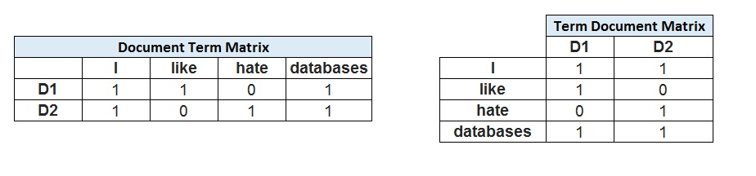
Term Document Matrix
For Example, if one has the following two (short) documents:
D1 = "I like databases"
D2 = "I hate databases",
Notes:
For examples,
There are two documents D1 and D2.
D1 has the statement…
D2 has the statement…
Now you can see how a Term Document Matrix looks like :
Rows contain the words
Columns contain which document the words belong to.
The matrix gives us the frequency distribution of the words in each and every document.
You can see “I” and “databases” appear in both the documents, so it shows a 1
Like appears in document 1 but not in document2
Similarly you can fills the frequencies for hate as well.
A document term matrix is just the transposed version of the TDM

Slide 15
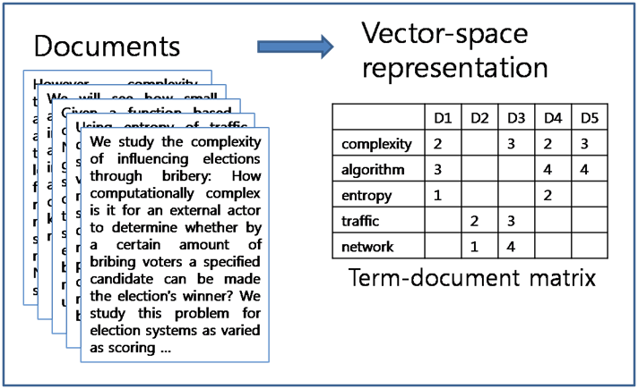
Term Document Matrix
Notes:
In a realistic scenario each document may have multiple sentences,
In which case you can see here how the TDM reports the frequencies.
Here the word algorithm occurs 3 times in document 1doesn’t occur in document2 and 3 , occurs 4 times in document 4 and 5.

Slide 16
Term Document Matrix
Sparse Terms
Most terms will be used infrequently and won’t add value to the analysis . Remove .
Notes:
Next step is that we remove sparse terms.
Sometimes, there are many words which occur infrequently across documents. They don’t add value to the analysis . Hence we can Remove these words.

Slide 17
INDEX
Introduction to tm package
Pre-processing the data
What is a Term Document Matrix?
What analysis can be done using a Term Document Matrix?
Implementation in R

Slide 18
What analysis can we do with TDM’s?
Finding Frequent Terms
The terms that occur many times in the document
Word Cloud gives us a visualisation of frequent terms
Finding Associations
Terms that are co-related or similar to each other
Notes:
There are loads of analysis and techniques that can be implemented using a TDM.
Let’s dicuss a few basic ones.Further in the session we will also learn how to implement these in R.
Firstly Finding Frequent Terms
We can analyse what are the most frequently occurring terms in a given document or across documents
This can further be visualised using word clouds.
Next, we can try and understand how are words with the documents co related to each other.
For example, Let’s look at a political document about “Obama’s relationships with other nations in the world”.So here We might want to try and understand which all countries Obama visited to strengthen relationships between countries.So we might try and look at co rrelation between words such as “Obama” and “Modi”, or “Obama” and “Stephen Harper” who is the prime minister of canada,.Basically how many times do they occur in the same document .
So a strong co occurrence of these words in the same document might lead to a conclusion that he has visited that particular country or shared some meetings with that particular prime minister and so on.

Slide 19
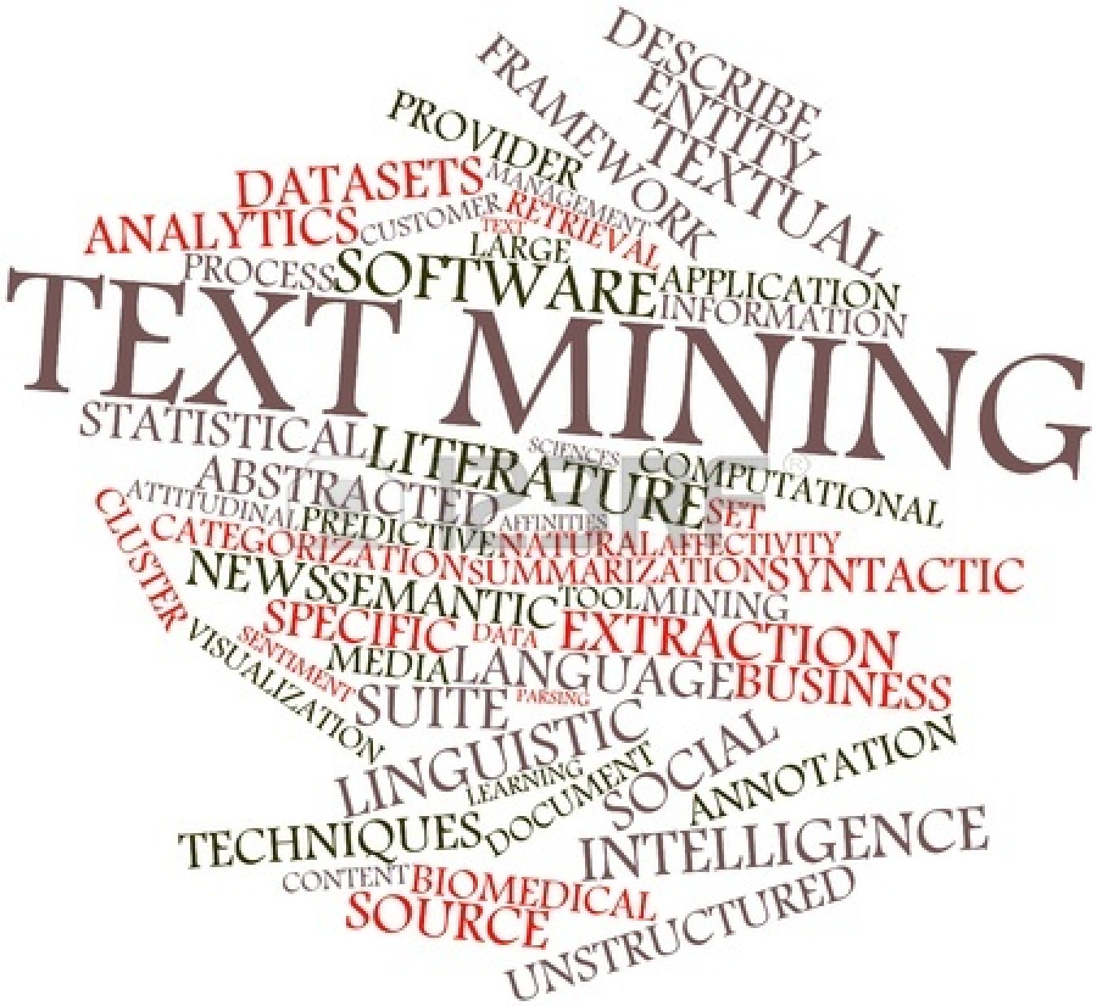
What analysis can we do with TDM’s?
Word Clouds :
It highlights the most commonly cited words in a text using a quick visualization
Notes:
So here you can see how a word cloud looks like.
It highlights the most commonly cited words in a text using a quick visualization.
In this case the document mostly spoke about TEXT mining, apart frm that we see words like statistics, intelligence, unstructured,literature and so on.
The difference is explained by the Size of the word visualised.

Slide 20
What analysis can we do with TDM’s?
Clustering :
Separates records into groups that are similar with respect to the terms contained in each record
Sentiment Analysis :
Process of computationally identifying and categorizing opinions expressed in a piece of text: positive, negative, or neutral
Notes:
Closing Audio to be recorded
Under this topic we have discussed in detail about
…..
That’s it for this topic.
For any queries, do email us at info@jigsawacademy.com
Thanks!

Slide 21
INDEX
Introduction to tm package
Pre-processing the data
What is a Term Document Matrix?
What analysis can be done using a Term Document Matrix?
Implementation in R
Notes:
Source of information : Reviews from various websites through google search
From this source, we extracted the “dimensions” of the data – which is nothing but the words in the reviews. This adds some implicit structure to the otherwise unstructured data we’re dealing with.
The goal is to identify which are the best books to read.

Slide 22
Implementation in R
Notes:
Closing Audio to be recorded
Under this topic we have discussed in detail about
…..
That’s it for this topic.
For any queries, do email us at info@jigsawacademy.com
Thanks!

Slide 23
RECAP
Notes:
Closing Audio to be recorded
Under this topic we have discussed in detail about
…..
That’s it for this topic.
For any queries, do email us at info@jigsawacademy.com
Thanks!

Slide 24
THANK YOU

